Slide 1
DashTricks: Pakistan

Slide 2
Team
Jennifer Apacible
Brian Donohue
Austin Hedeen
Daniel Luna
Dov Shlachter

Slide 3
Problem
Although vaccination has saved countless lives in Pakistan, many still die due to inefficiencies in the vaccine cold chain allocation and distribution system
Resource allocation for vaccine cold chains is time consuming and error prone
Problem areas have low visibility, potentially leading to vaccine shortages

Slide 4
Solution
Automate as much of the cold chain calculation as possible
Allow users to simulate different types of scenarios
Epidemics, new vaccines, etc.
Point out potential problem areas
Suggest ways to deal with hotspots based on available resources

Slide 5
Customers
Those with a vested interest in improving the cold chain network in Pakistan.
Example customers include:
Regional / District Managers
Potential Donors
Vaccine Advocates
Aid Groups

Slide 6
Challenges
Technical
Constrained to the Android platform
Complexity of cold chain modelling
Data not always in readily usable forms
Environmental
Time
Data entry amount, format, & correctness
Lack of domain specific knowledge
Minimal feedback & product iteration with customers

Slide 7
Requirements
Calculate cold chain resource requirements
Model current resource levels
Allow for easy extending of resource requirements
Suggest future resource allocation
Show potential problem areas
Update to future data

Slide 8
UI & Workflow

Slide 9
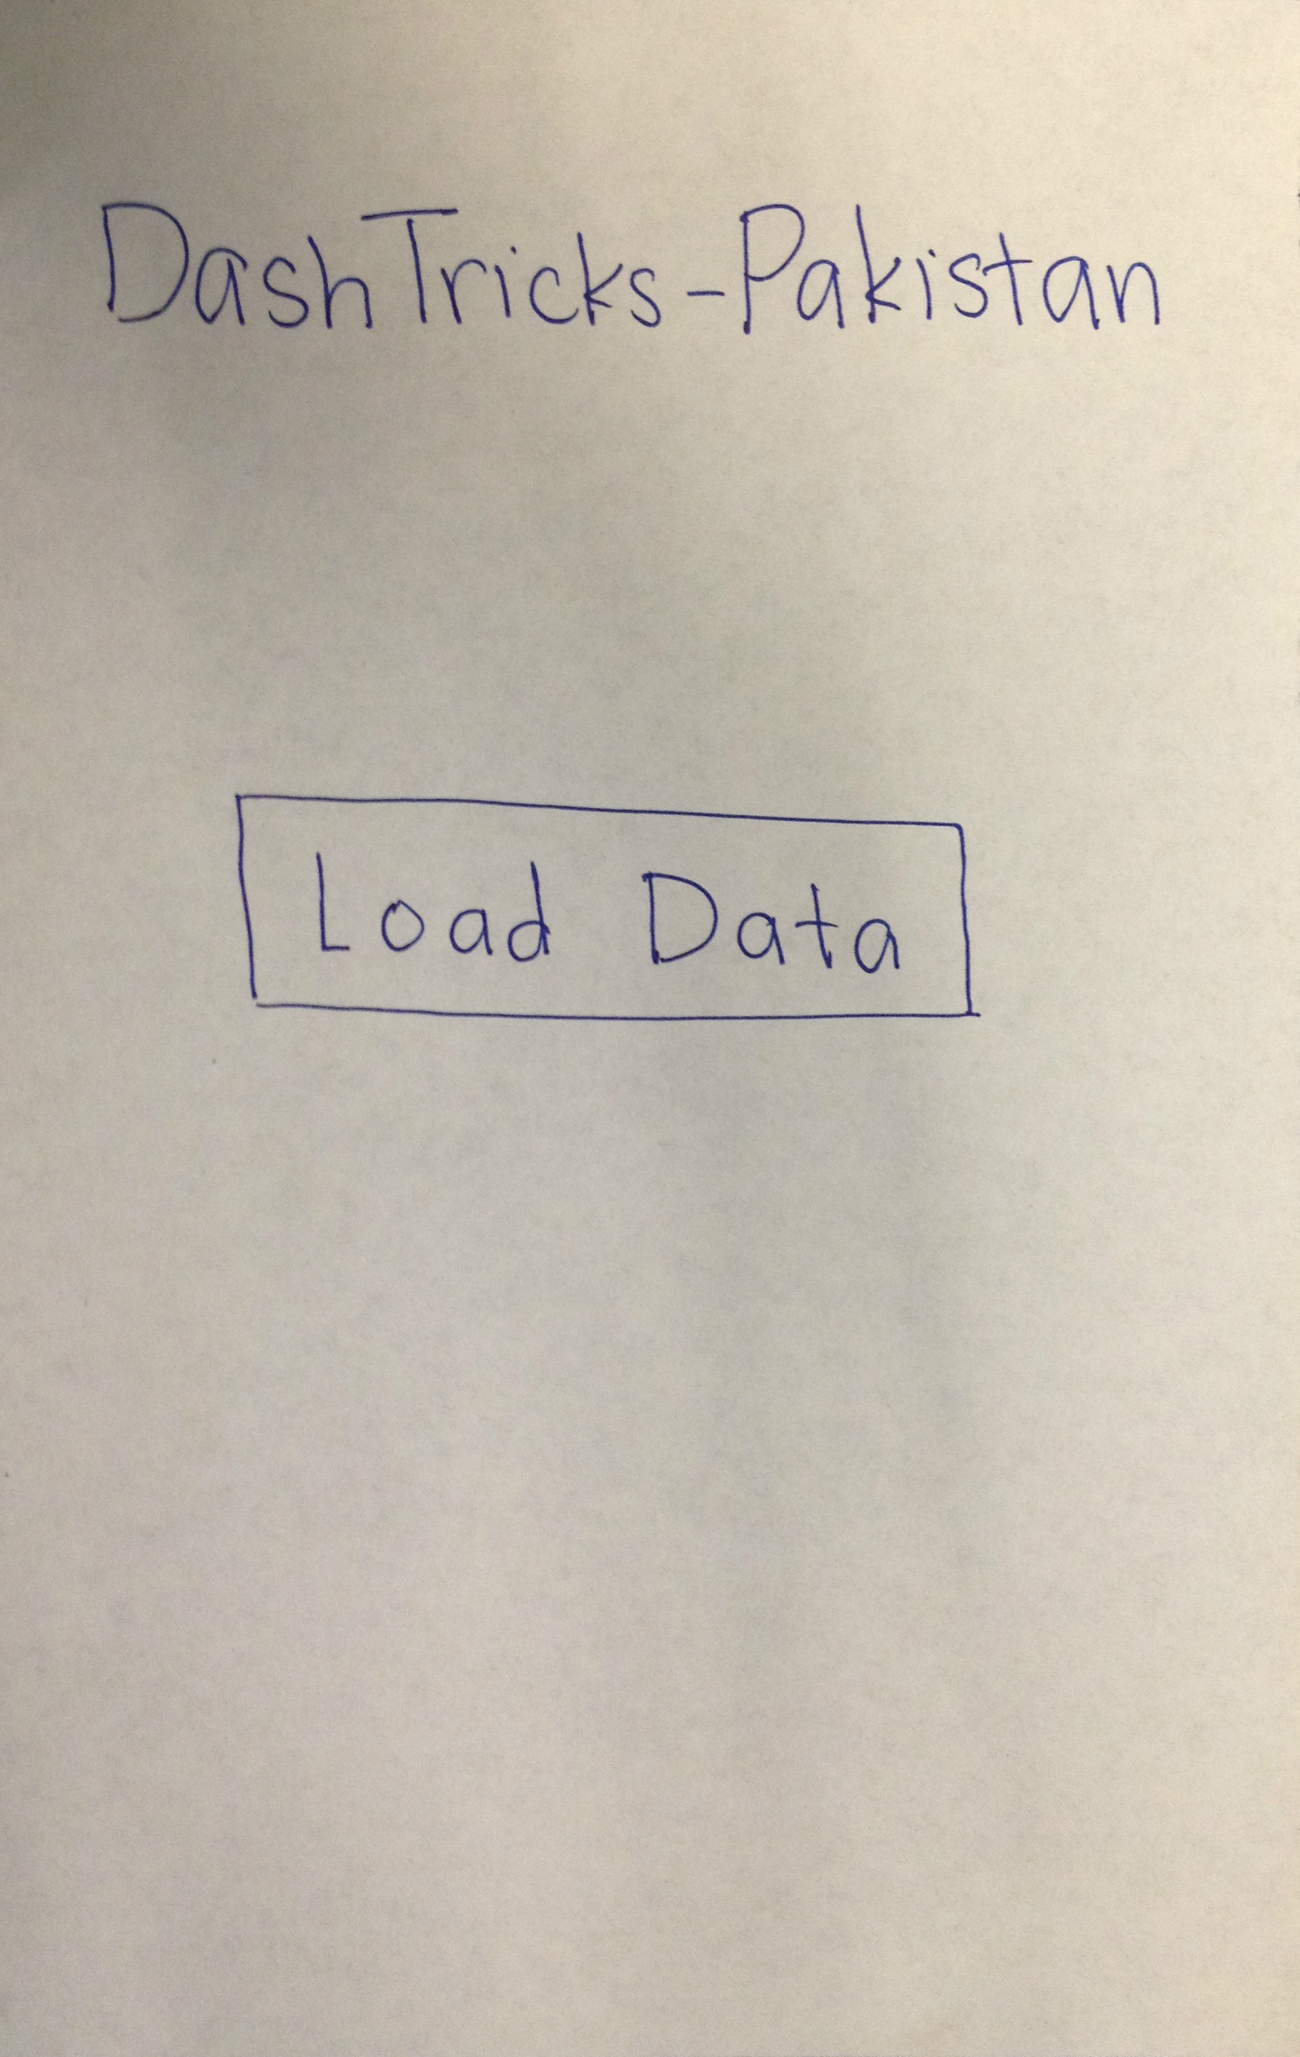
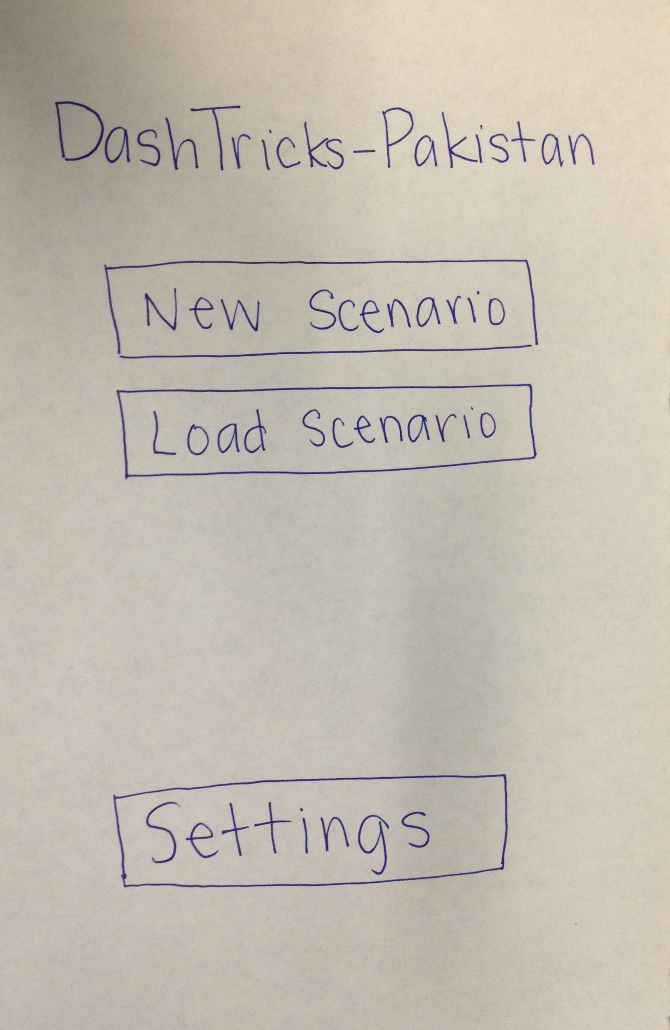
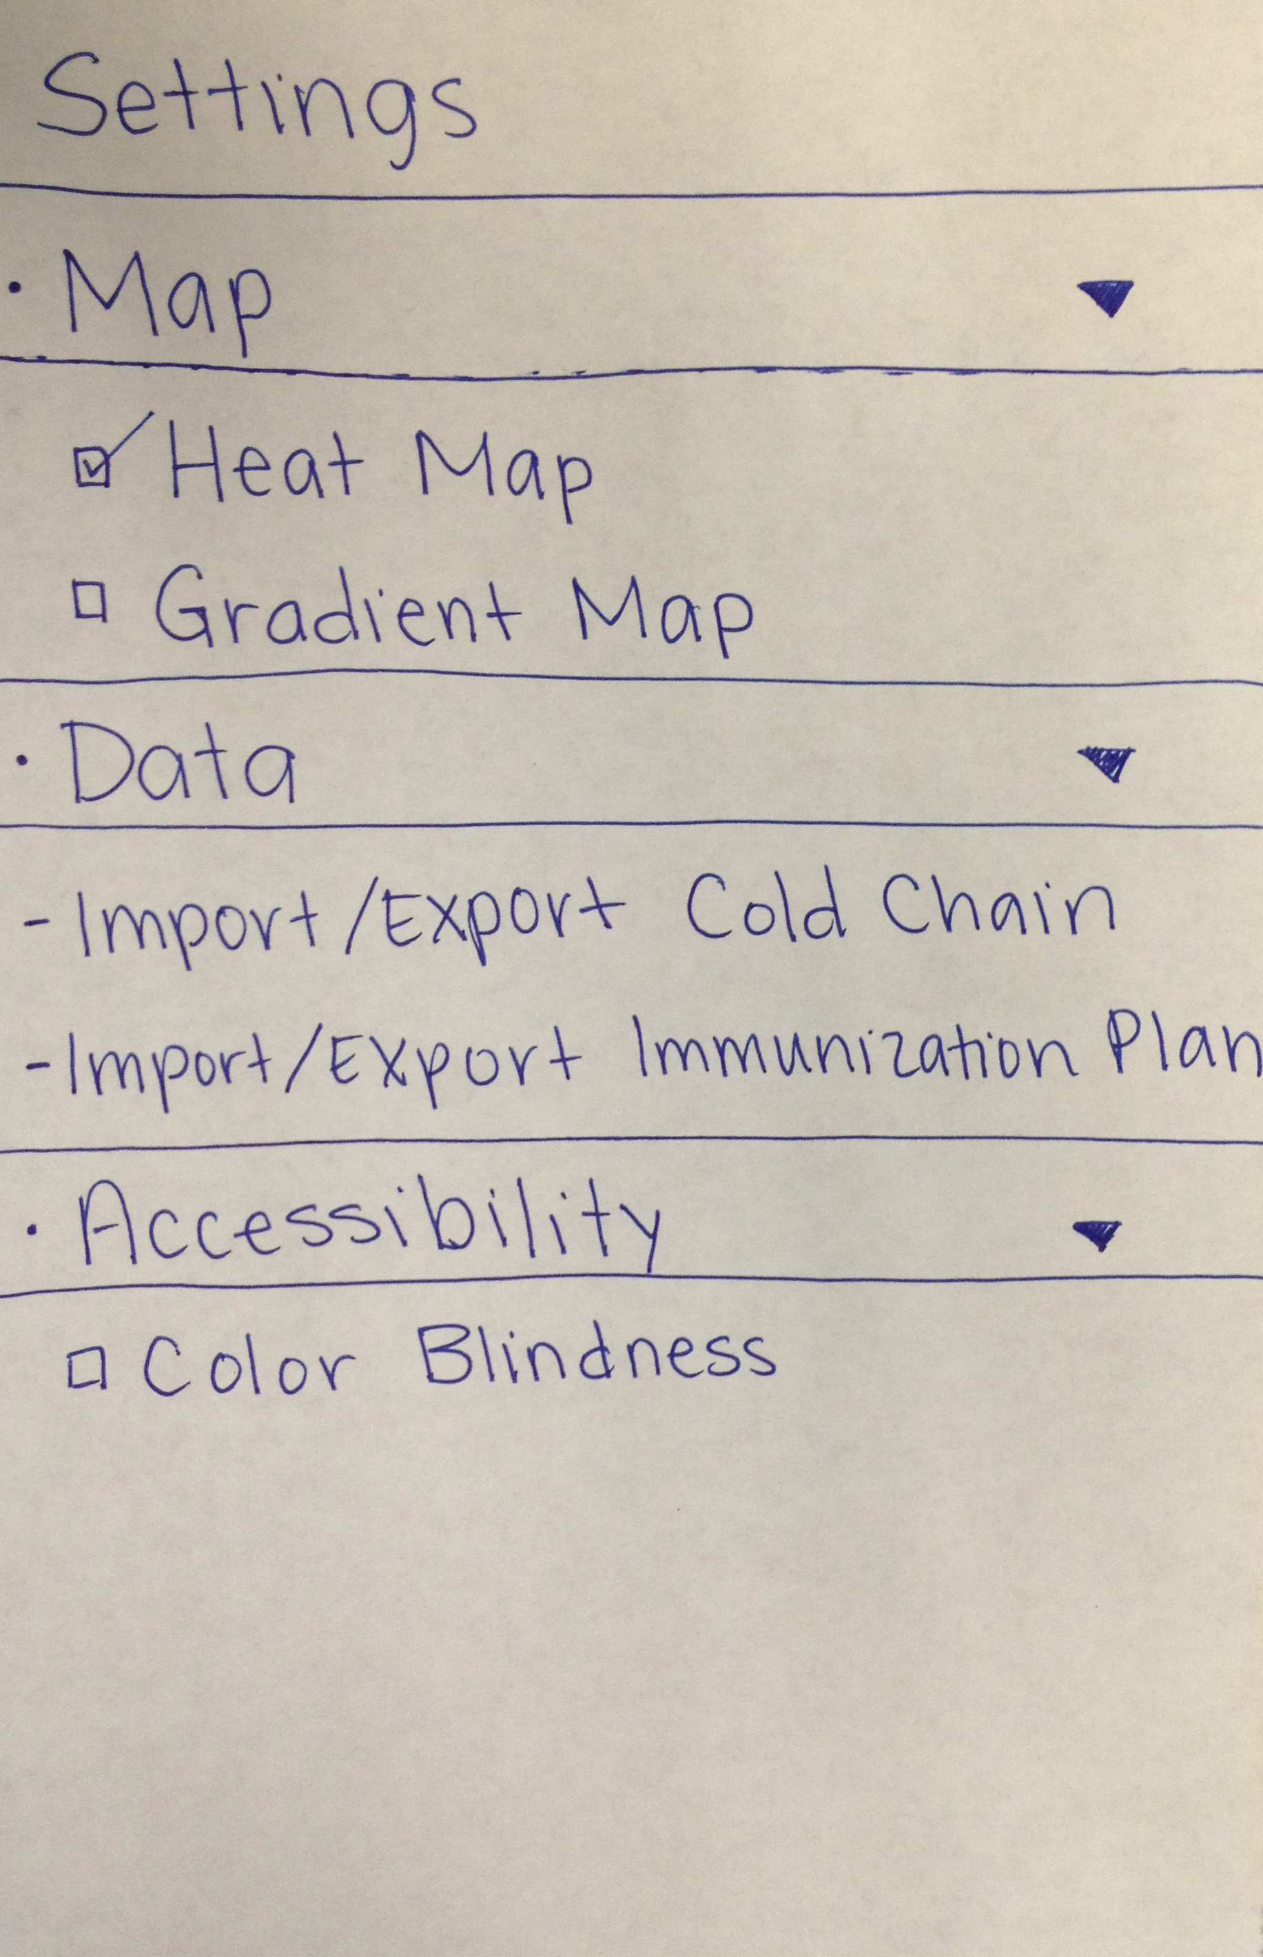
UI & Workflow

Slide 10
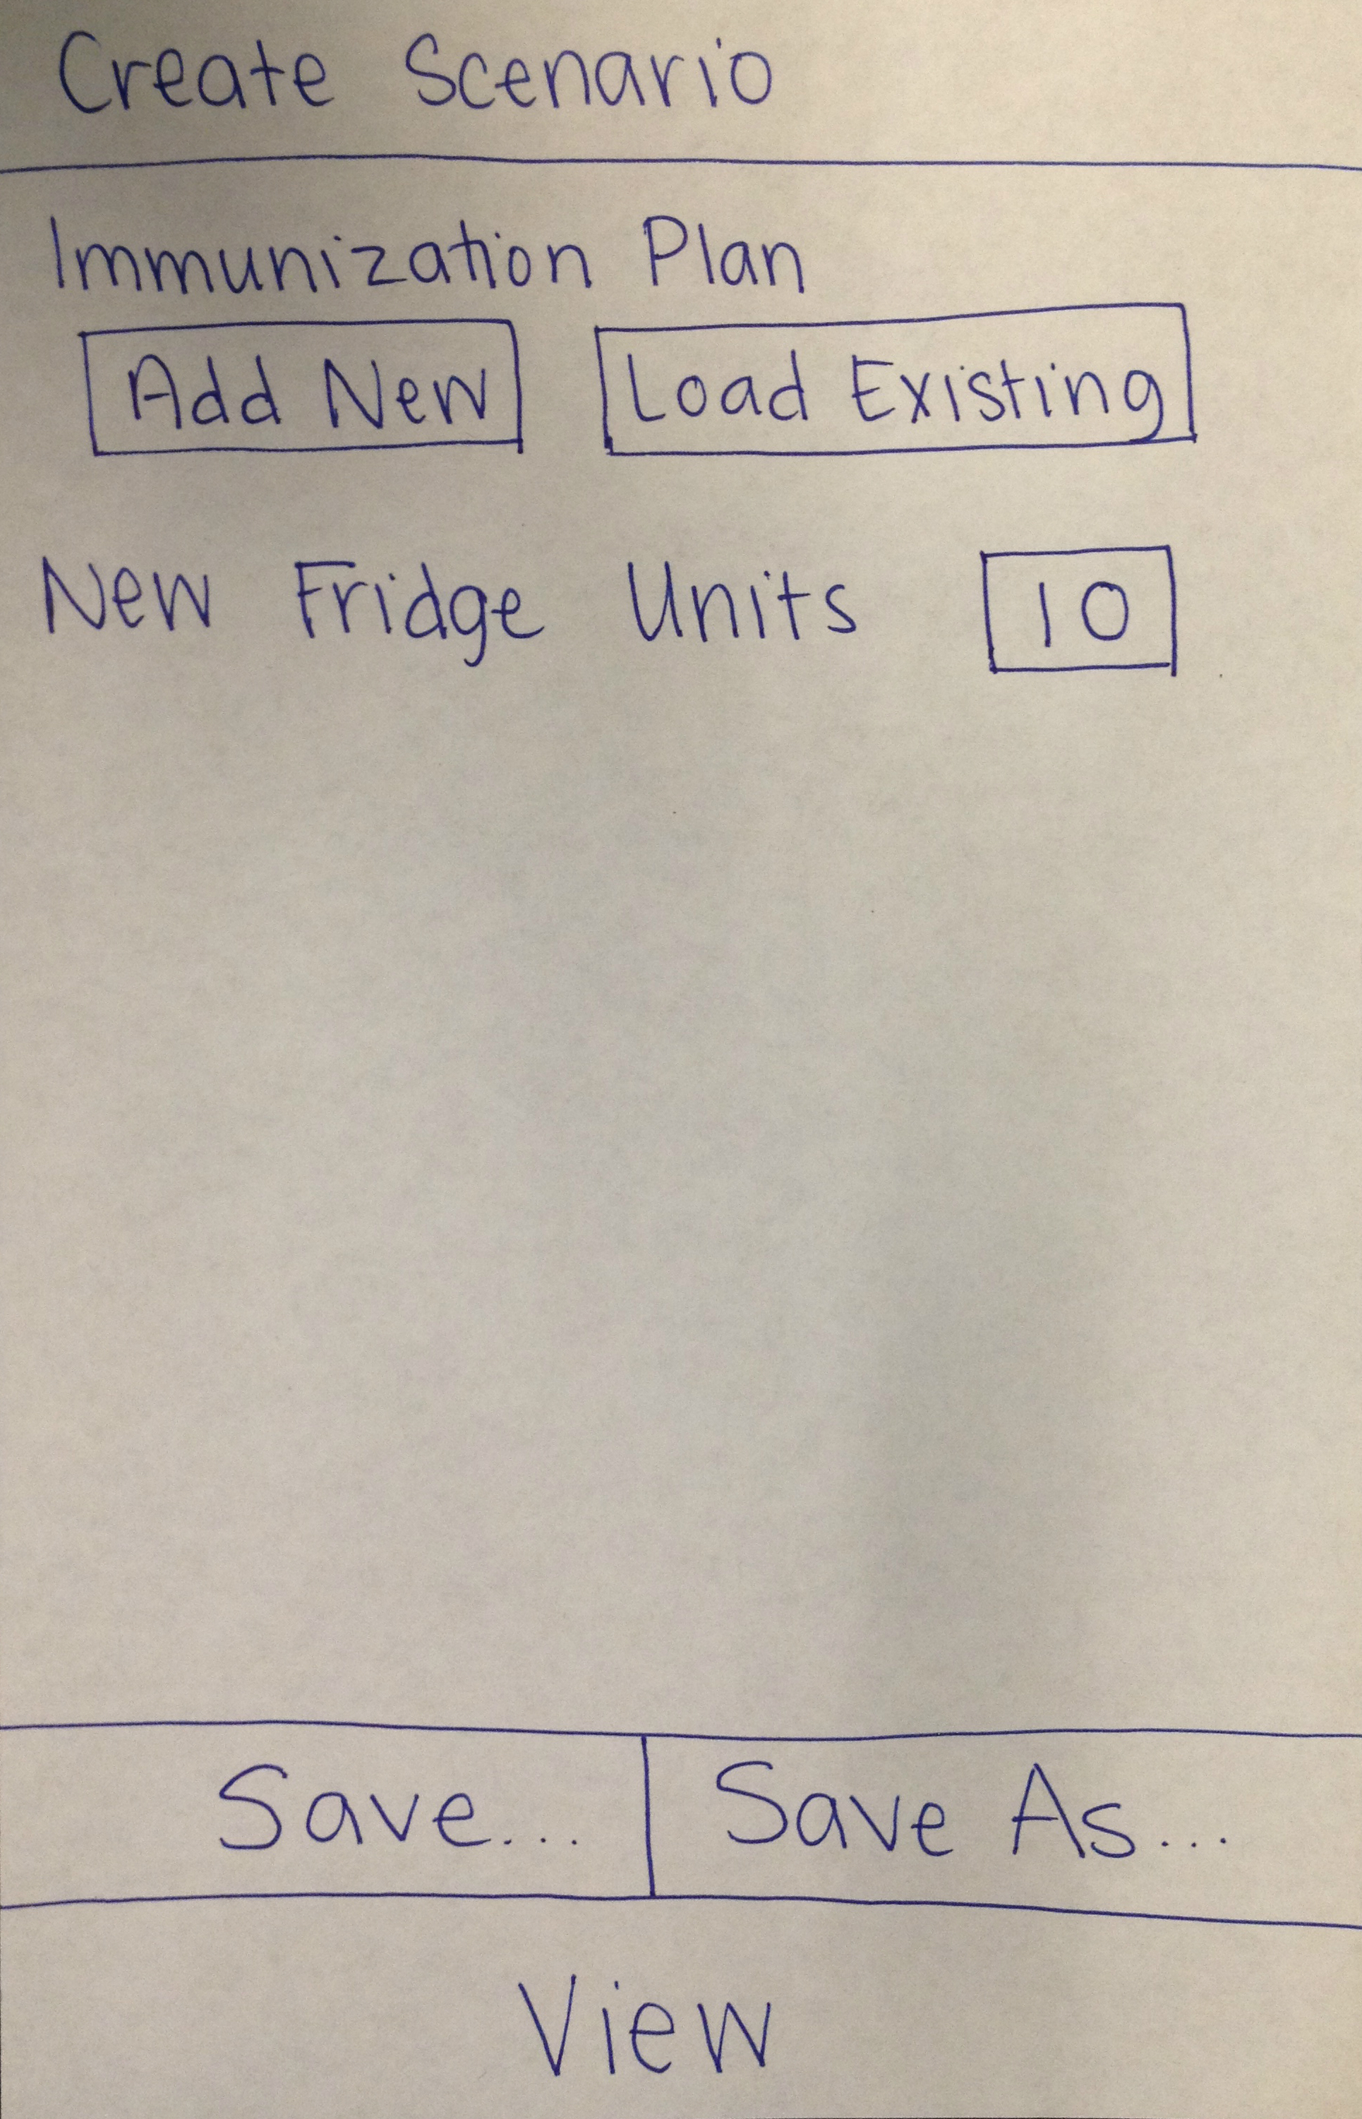
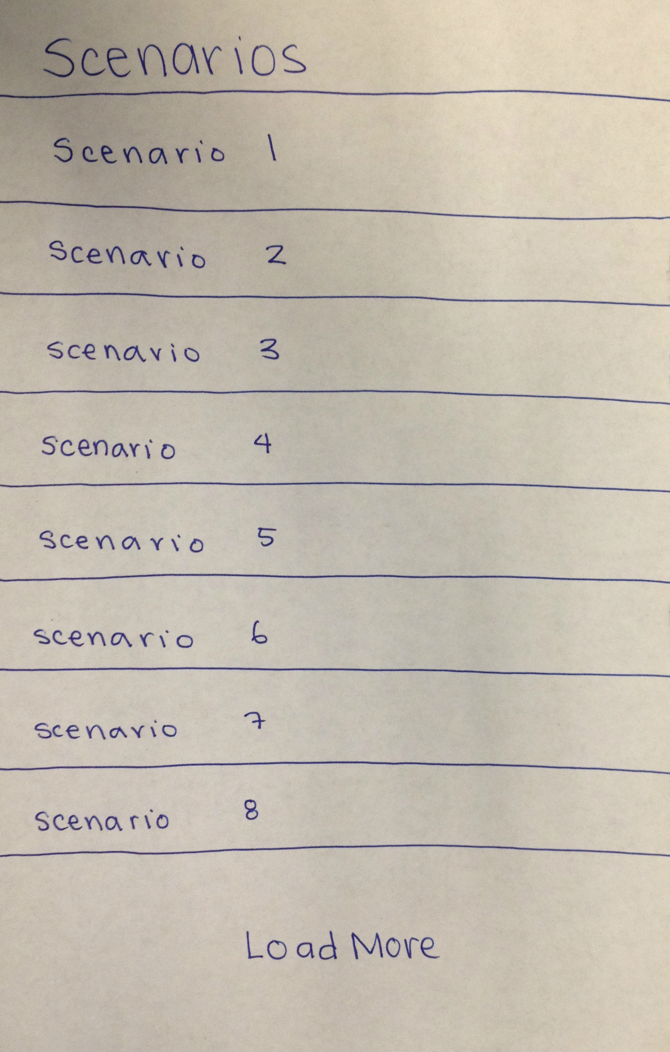
UI & Workflow

Slide 11
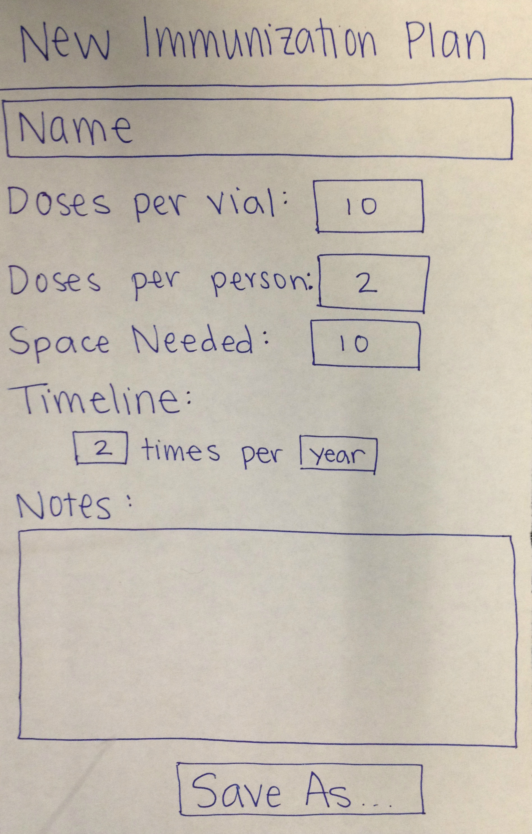
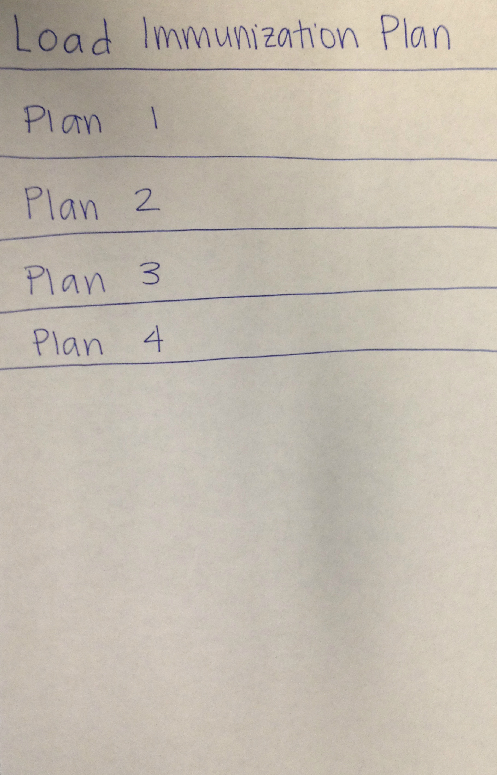
UI & Workflow

Slide 12
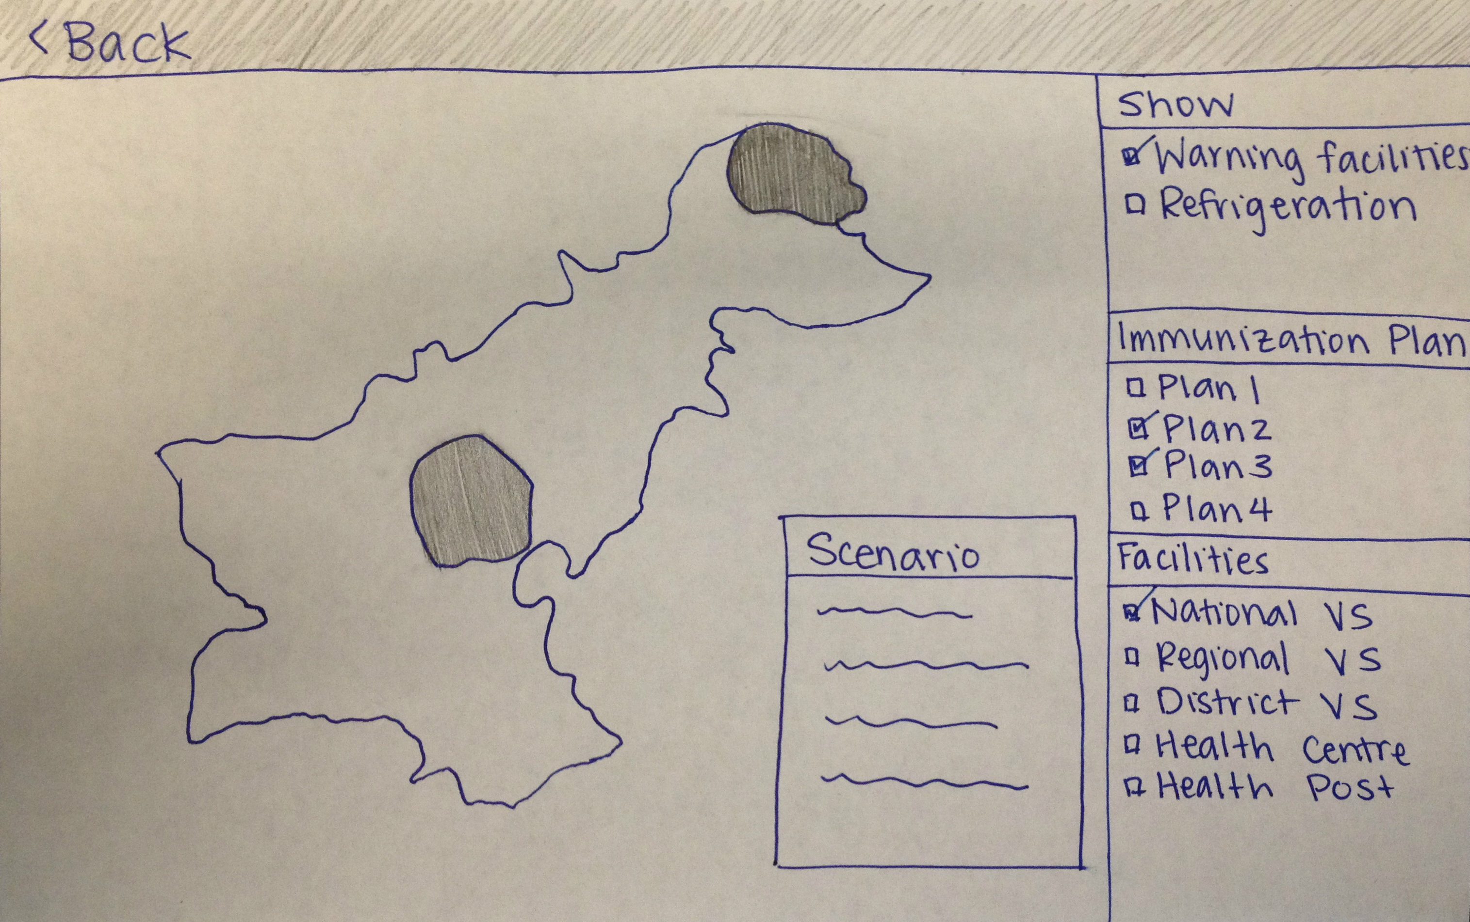
UI & Workflow

Slide 13
System Architecture
Visualization Map
Immunization Data
Immunization Plans, Resource Information,
Scenarios,
Settings,
etc
----------------
Base Cold Chain Data
DataAccessor
Other Displays
Cold Chain Data

Slide 14
Work Plan
Week 1: Introduction to domain and Android.
Week 2: External resource exploration. Workflow & UI prototyping. Schema prototyping.
Weeks 3 - 4: Required component creation.
Week 5: Integration. Creation of minimum viable product.
Week 6: Feature freeze. Dedicated testing and bug fixing.
Week 7: Alpha test begins. Work on secondary features begins.
Weeks 8 - 9: Alpha test feedback received, and incorporated. Secondary features finalized.
Week 10: Feature freeze. Dedicated testing and bug fixing. Project write-up.

Slide 15
Questions?
https://github.com/japacible/DashTricks-Pakistan

